Slide 1
How to feed a hungry pack of Raptors fans?
Holly Clark, Daniel Tsai &
Joel Fernandes

Slide 2
The back Story…
McDonald’s struct a promotional deal with the Toronto Raptors a head of the 2018-2019 season, the deal applied to Ontario restaurants.
For every 12 or more 3 pointers the Raptors scored in a game, McDonald’s would give away a free order of medium fries.
McDonald’s projected they’d give away 700,000 orders of free fries…
Projection influenced by a previous fry give away with the Montreal Canadiens.
McDonald’s presumed the Raptors would win nearly half of its 82 regular season games.
After the Toronto Raptor’s winning the NBA Championship, McDonald’s had given away nearly 2 million orders in free fries…worth $5.8 million.
Notes:
Summary Slide
# McDonald's gave away millions of dollars in free medium French fries during the 2018-2019 season for every game when the Raptors scored 12 or more 3 pointers. According to a Financial Post article, McDonalds had given away 2 million medium orders of french fries, that's nearly 3 times the 700,000 orders the company projected its Ontario restaurants would give away during the promotion. The regular season's two million free orders, at an average menu price of $2.89 was $5.8 million worth of fries. McDonald's had forecasted it's projections for the Raptors based on a previous fry give away program with the Montreal Canadiens. Although McDonald's head office isn't concerned about giving away over $5 million in free french fries, Head of Marketing for McDonald's in Eastern Canada, Chuck Cooleen, said headoffice is concerned about the strain on franchise owners to meet the demand of the promotion. A McDonald's franchise owner in reported they had to hire an additional line cook for the day, during the promotion on an average day one location gave away 500 free orders of french fries, the highest record give away was 960 for this location. The McDonald's promotion was designed to drive customers to the restaurants mobile application to place orders, as customers woudld have to place their order for free fries through the mobile application; allowing McDonalds to collect data about their customers.

Slide 3
Hypothesis
Based to 2016-2017 & 2017-2018 player statistics, could McDonald's have predicted the Raptor’s would be so successful in their 2018-2019 season…triggering McDonald's promotional give away of free fries when the Raptors score 12 or more 3 pointers?
Null Hypothesis: McDonald’s could have not predicted the Toronto Raptors would do so well during their 2018-2019 season.
Notes:
Motivation * Define the core message or hypothesis of your project.
* Describe the questions you asked, and _why_ you asked them
* Describe whether you were able to answer these questions to your satisfaction, and briefly summarize your findings
In inferential statistics, the null hypothesis is a general statement or default position that there is no relationship between two measured phenomena or no association among groups

Slide 4
Questions & Data
Questions:
How many games did the Raptors score 12 or more 3 pointers during the 2016-2017 & 2017-2018 season?
Which players scored the most 3 pointers during the 2016-2017 & 2017-2018 season?
How does the number of days off ‘Time Rested’, impact the number of 3 pointers per game?
Did the Raptors score more 3 pointers at home or away games?
Does a player’s age impact the number of 3 pointers they make?
Data Source: stats.nba.com , bastketballreferences.com
Notes:
Motivation * Define the core message or hypothesis of your project.
* Describe the questions you asked, and _why_ you asked them
* Describe whether you were able to answer these questions to your satisfaction, and briefly summarize your findings

Slide 5
Data Clean Up & Exploration
Manually took individual player statistics from sources.
Challenges merging all player data into a cohesive data frame.
Raw player data was organized by game Date
Grouped by dates per season
One pandas data frame for each player for each season, concatenated all data frames into a list.
Loc function
No unique keys or values.
Notes:
* Data Cleanup & Exploration
* Describe the exploration and cleanup process
Manually took individual player statistics from sources and converted it to a csv file.
Each player had its own csv file because our source organized individual player statistics by date.
We faced challenges merging all player data into one cohesive data frame per season.
We concatenated all player data frames into one data frame per season.
* Discuss insights you had while exploring the data that you didn't anticipate
We did not anticipate the challenges when you have no unique keys in the data frame…the date was the most unique data, but multiple players played on that same date.
* Discuss any problems that arose after exploring the data, and how you resolved them
The loc function in pandas allowed us to specify certain dates and players we’d like to look at.
* Present and discuss interesting figures developed during exploration, ideally with the help of Jupyter Notebook
Number of game where the amount of 12 pointers was 3 or more.

Slide 6
Initial Findings:
2016-2017:
The Raptors scored 12 or more 3 pointers in 18 games .
Scored 813 total 3 pointers for the season.
Scored an average of 35.98 % for every 3 pointer attempt made.

Slide 7
Data Analysis: How many games did the Raptors score 12 or more 3 pointers during the 2016-2017 & 2017-2018 season?
Notes:
* Data Analysis
* Discuss the steps you took to analyze the data and answer each question you asked in your proposal
* Present and discuss interesting figures developed during analysis, ideally with the help of Jupyter Notebook

Slide 8
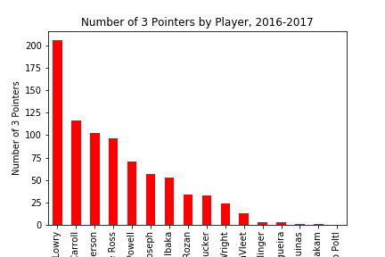
Data Analysis: Which players scored the most 3 pointers during the 2016-2017 & 2017-2018 season?

Slide 9
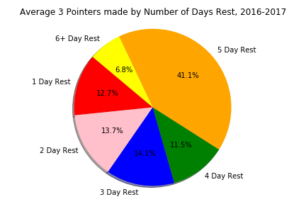
How does the amount of ‘Time Rested’, impact the number of 3 pointers per game?

Slide 10
Did the Raptors score more 3 pointers at home or away games?

Slide 11
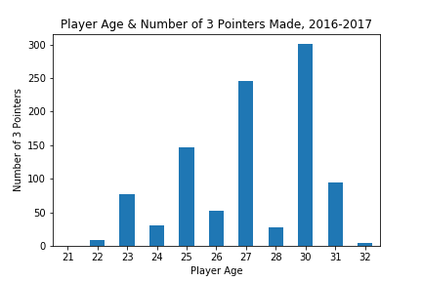
Does a player’s age impact the number of 3 pointers they make?

Slide 12
Findings & Discussion
Total Games with 12 or more 3 pointers made:
2016-2017: 18
2017-2018: 53
CJ Miles, Serge Ibaka & OG Anunoby were trop contributors during 2017-2018 season. However, CJ Miles & OG Anunoby did not play during 2016-2017, Serge Ibaka joined mid-season 2016-2017.
Notes:
* Discussion
CJ Miles, Serge Ibaka & OG Anunoby were top contributors to the number of 3 pointers made in the 2017-2018. However, these players joined mid-season during the 2016-2017 season. This explains the steep increase in the number of games were the Raptors scored 12+ 3 pointers. During the 2016-2017 season the Raptors had 18 games where they scored 12 + 3 pointers, compared to 53 games in the 2017-2018 season.

Slide 13
Conclusion
The purpose of the McDonald’s promotion was to encourage customers to download the McDonald’s mobile app, in order to access the free fry's promotion.
To ensure the greatest number of prospective customers, it was in McDonald’s best interest to minimize the number of 3 pointers required for the promotion.
Notes:
* Post Mortem
* Discuss any difficulties that arose, and how you dealt with them
* Discuss any additional questions that came up, but which you didn't have time to answer: What would you research next, if you had two more weeks?
Based on 1718 rosters
It’s not too easy or too hard to get 12 3 pointers

Slide 14
Thank you!
Questions & Answers

